Slide 1

BOOK MY EVENT @ BMSCE
SUBMITTED BY:
ANKITH B RAO - 1BM17IS011
H ANARGHYA - 1BM17IS028
LALITASHREE R HEGDE 1BM17IS039
PANNAGA SHARMA M L - 1BM17IS053

Slide 2
CONTENTS
1.
Problem Statement
2.
Frontend requirements
3.
Requirements of the database
4.
Java database connectivity

Slide 3

Problem Statement
1
To design and develop an application for registration of various events held at BMSCE during the fests, by the numerous student clubs and department clubs present in BMSCE.
The application includes an admin login in which he/she can update, add or remove the events as the organizers of the events wish. It also includes student registration where students or any student who wish to participate can look for the events of their interest and register for the same.

Slide 4
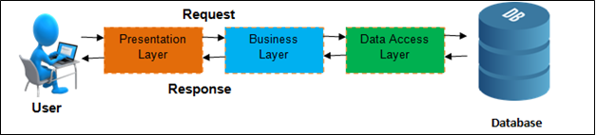
3 - tier Architecture
The project follows 3 tier architecture.This DBMS architecture contains an Application layer between the user and the DBMS, which is responsible for communicating the user's request to the DBMS system and send the response from the DBMS to the user.
The application layer(business logic layer) also processes functional logic, constraint, and rules before passing data to the user or down to the DBMS.

Slide 5
Frontend requirements
2
Software used for the designing the user interface: Swing.
Swing is a GUI widget toolkit for Java. Swing was developed to provide more sophisticated set of GUI components than the earlier toolkit, i.e., Abstract Window Toolkit(AWT).Swing does not replace it,but is built on its foundation. Swing is a lightweight toolkit , it has lightweight components when compared to AWT. It also has a pluggable look and feel.
The user interface in swing is referred to as frames and the connectivity between one User interface page and the other would be through connecting the frames using Swing.The user interface for our project will include a home page containing the options like ‘about’, ‘registration’, ‘events’ ,each of which will be redirected to their respective pages. Students will be asked to register for their desired events through a registration form and the confirmation will be sent to their respective emails.

Slide 6
Requirements of the database
3
1.The various events are organised and handled by different clubs. Each club has a unique name, unique id, the department which handles it and the admin who manages the club.
2.Each club handles one or more events and for each event, we store the event number, event name, the date, the venue at which it will be held and the club handling it.
3.We store the details of each student who have registered for a particular event. We store their USN, name, semester to which they belong, their contact details and the event for which they have registered.

Slide 7
ER MODEL
CPhone
USN
CName
C_Id
Name
Name
Phone
COORDINATOR
CLUB
REGISTERED_STUDENT
(0,N)
Email_Id
(1,1)
(1,1)
(1,N)
Desc
Paid
Sem
Manag-ed_By
Organis-es
Particip-ates_In
(1,1)
(1,2)
(10,N)
Event_id
Adm_ID
ADMIN
EVENT
Fee
Time
Name
Date
Rules
Description
Login_psw
Venue
Email
Res_person
Ename

Slide 8
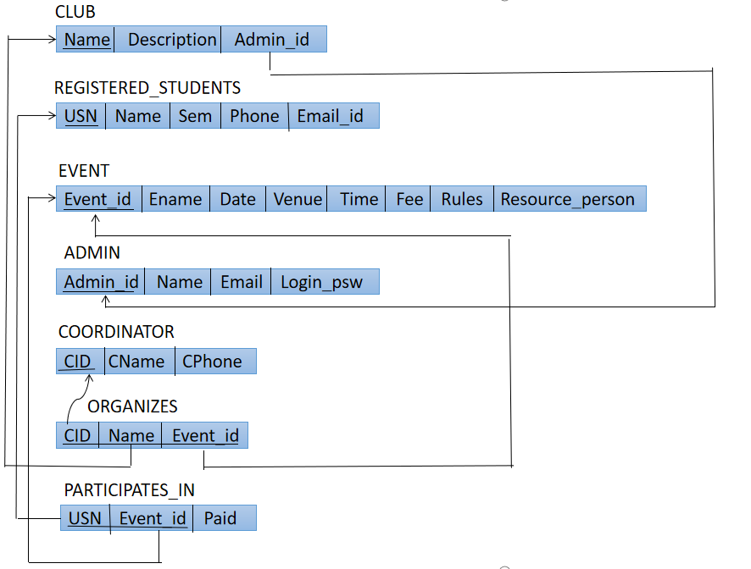
ER to Table Mapping

Slide 9
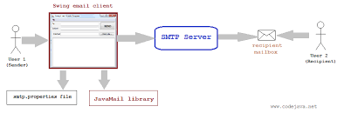
Sending Email
we have added one more table to our database i.e., “card_details”,which stores the details of the card.

Slide 10
4
JAVA and Database connectivity
Java Database Connectivity (JDBC) is an application programming interface (API) for the programming language Java, which defines how a client may access a database. It is a Java-based data access technology used for Java database connectivity.It provides methods to query and update data in the database. And it is oriented towards relational databases.
JDBC allows multiple implementations to exist and be used by the same application. The API provides a mechanism for dynamically loading the correct Java packages and registering them with the JDBC Driver Manager. The Driver Manager is used as a connection factory for creating JDBC connections.
JDBC connections support creating and executing statements. These may be update statements such as SQL's CREATE, INSERT, UPDATE and DELETE, or they may be query statements such as SELECT.

Slide 11
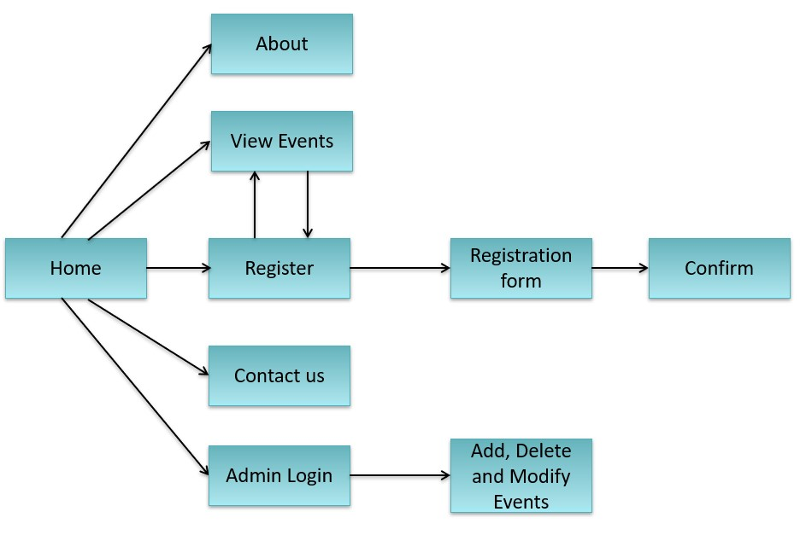
Linking of modules

Slide 12
THANK YOU！

